Slide 1
Tableau
Interactive Dashboard

Slide 2
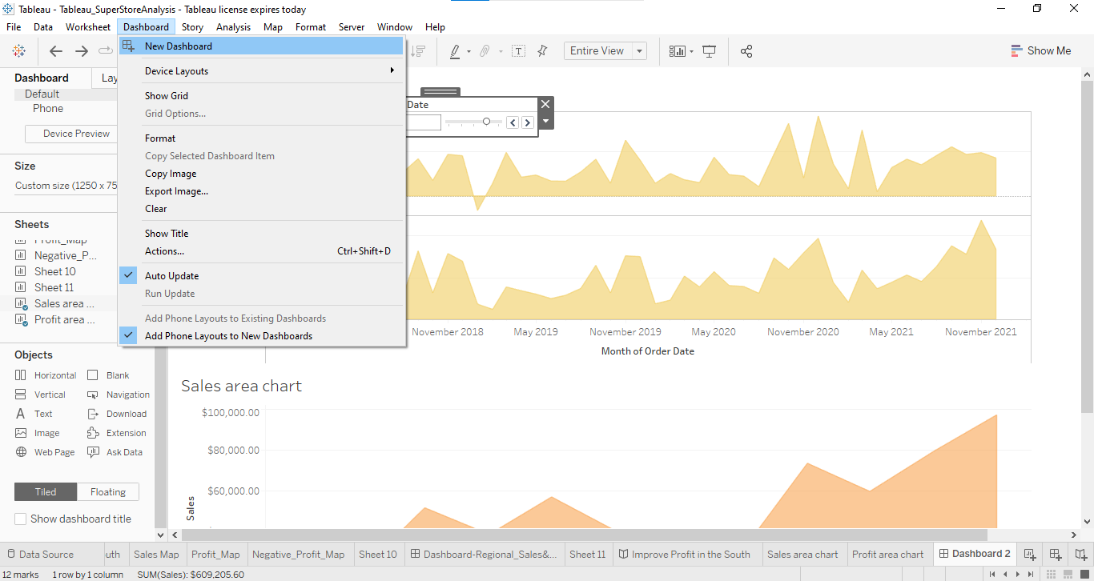
Build dashboard to show some insights. Arrange Your Dashboard.

Slide 3
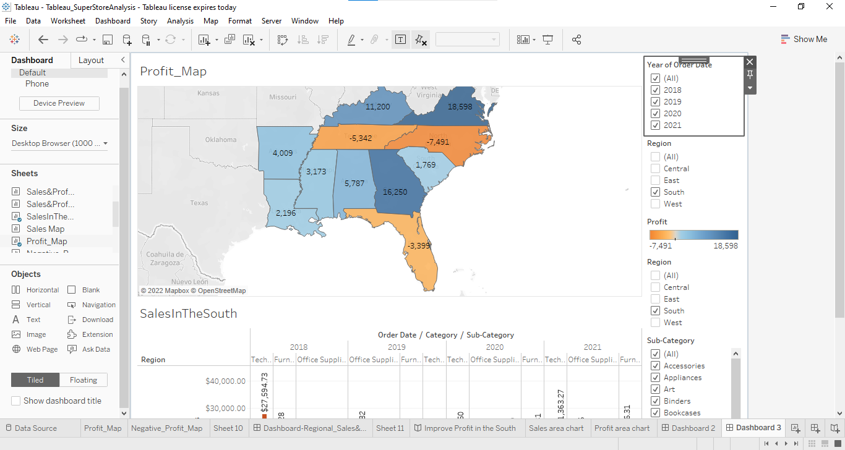
Remove the subcategory filter option to vacate the space. Remove the year of order filter option to vacate the space.

Slide 4
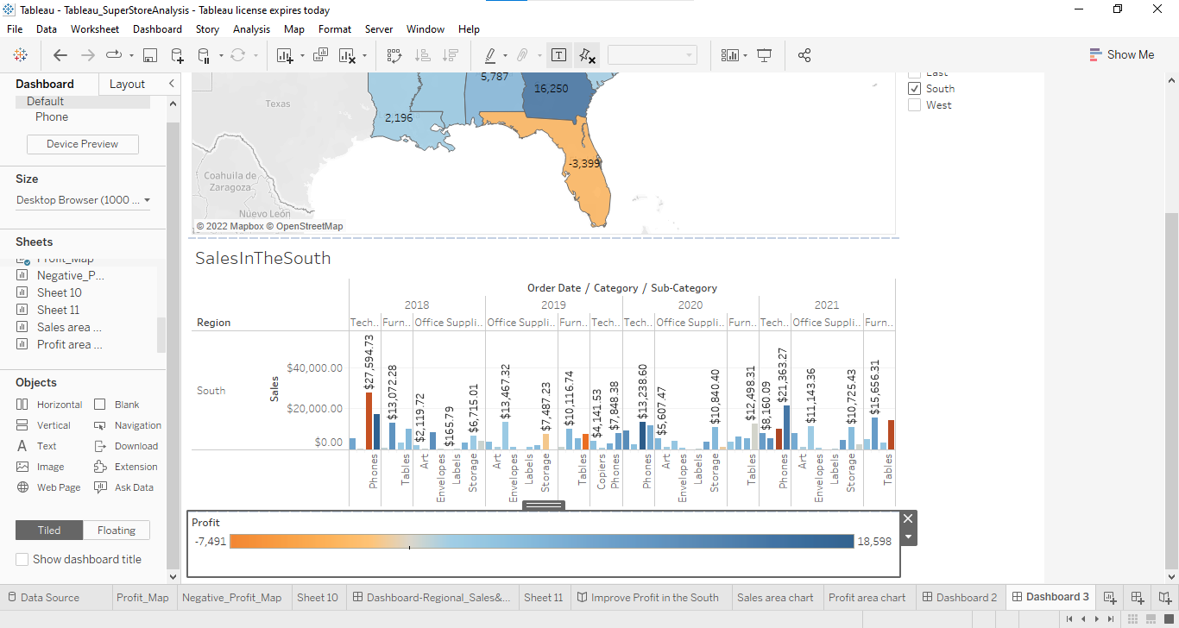
Select Profit color legend and drag it to Sales in the South.

Slide 5
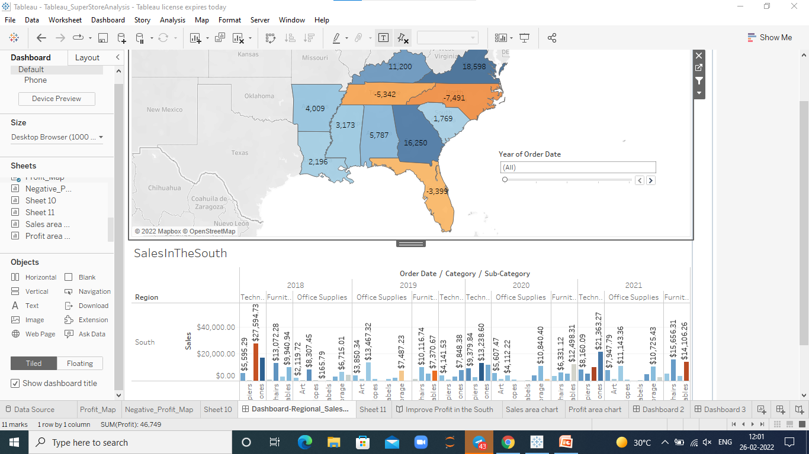
Make your dashboard interactive. Make the order date filter applicable for sales in the south visual as well.

Slide 6
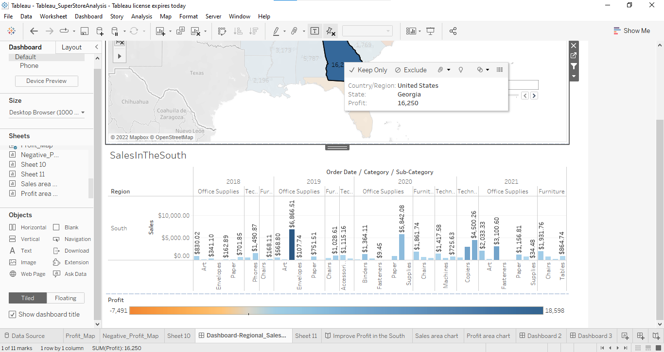
One by one click all the states in the profit map having negative profit and check both profit and sales for each state.

Slide 7
Rename your dashboard and save as Regional Sales and Profit.

